Slide 1
INSTITUTE MANAGEMENT SYSTEM
Presented By:
1.Chirag Modi
2.Kirtan Shah
3.Abhishek Prasad

Slide 2
Slide Contents
Objectives
Introduction
Problem Statement
Modules of Project:-
1) Student
2) Teacher
3) Parents/Guardians
4) Management Staff
5) Admin
Technology
Software Requirements
Hardware Requirements
Life Cycle Model
Why This Life Cycle Used?
Design Of Software:-
Function Oriented Analysis And Design(FOAD)
1) Context Diagram
2) DFD Level 1
3) DFD Level 2
Object Oriented Analysis And Design(OOAD)
1)Class Diagram
2)Use case Diagram
3) Activity Diagram
4)Sequence Diagram
Graphical User Interface(GUI)

Slide 3
Objectives
Nowadays, even a small institute have a large database to maintain. Initializing from there exam paper preparations to results, from students detail to faculty attendance, from project reports to extra activities, a small institute even generated a big database even in a month. Thus, In order to maintain such database and even to handle such kind of large activities, we need to have some automatically working system, which does not require much labor work and can be done easily.
This system is being generated for such purpose only to maintain all the work power of an institute in a single database server. This model will also be able to solve the problem of time as the current system is very time consuming and this project is being developed keeping in mind the time problem.

Slide 4
Introduction
This System provides online application for the Institute Management System.The system is an online application that can be accessed throughout the organization and outside as well with proper login ID and PASSWORD.Our main motive of this system is to provide attractive environment where we can manipulate data and information about students ,staff easily. Here we manage things like Student Admission Management, Fees and Salary Management, Online Attendance management, Time Table Management etc. Here we added some additional features also, for easy communication, and easy management. Our System is available on both modes – Online as well as Offline mode.
Users will be able to see their profiles and edit them. Administrator will be able to edit an access all the data that is stored with IMS.

Slide 5
PROBLEM STATEMENT
Problem 1.1: Lack of prompt updating
Today not all work but still some work at time of admission and registration of the students is done manually by ink and paper, which is very slow and consuming much efforts and time. So, it is required to design of the computerized Automation system of Institute, to speed up and make it easy to use system.

Slide 6
PROBLEM STATEMENT
Problem 1.2: Manual calculation
At a time of Result scenario faculty check answer sheets and calculate marks of each student. Which is very slow and consuming efforts and result declaration is delayed. So, this management system is able to do this things online.

Slide 7
PROBLEM STATEMENT
Problem 1.3: Student confusion
Some times students stayed confused that how he/she prepare for the exam/course and how to get batter material for the course. So,we provide the platform that he/she studied well and also provide online material for each course and online video lectures.

Slide 8
PROBLEM STATEMENT
Problem 1.4: Library managing
Now days, it is not easy task to do library work on papers and manage all the functionalities of library properly within lesser time because there are higher strength of student in Institutes.

Slide 9
PROBLEM STATEMENT
Problem 1.5: Lack of immediate retrievals
The information is very difficult to retrieve and to find particular information like – To find out about the student’s history, the user has to go through various registers. This results in inconvenience and wastages of time.

Slide 10
MODULES OF PROJECT
Student
The Student shall be able to login to System.
The Student shall be able to view Available Courses and Materials and Online video lectures.
The Student shall be able to download assignments and lectures ,And also able to Upload assignment.
The Student shall be able to pickup books from library and also return it .
The Student shall be able to view and print his/her Annual Report Card.
The Student shall be able to pay Fees with provided Online Modes.
The Student shall be able to solve his/her doubts online with expert faculty within provided time.

Slide 11
MODULES OF PROJECT
2) Teacher:
The Teacher shall be able to login to System.
The Teacher shall be able to Post Student’s Assignment and Materials.
The Teacher shall be able to Grade Student’s Exams and Provide 1 hour online doubt session for Students.
The Teacher shall be able to provide Class scheduling Information.
The Teacher shall be able to Post Exams.

Slide 12
MODULES OF PROFECT
3) Parents/Guardians:
Parents should be able to Login to the System.
Parents should be able to see Progress report of their child.
Parents should be able to apply online query through Email.
Parents should be able to contact Managing staff or respected Faculties.

Slide 13
MODULES OF PROJECT
4) Management Staff
He/ She shall be able to Login to the system.
He/ She shall be able to Manage online queries or inquiries.
He/ She shall be able to Manage class schedule.
He/ She shall be able to contact students or parents for other issues.
He/ She shall be able to proceed further process of Admission.

Slide 14
MODULES OF PROJECT
5) Admin
The Admin shall be able to Login to the system.
The Admin shall be able to Add and Delete or Edit courses.
The Admin shall be able to assign Teachers to courses or remove teachers from course.
The Admin shall be able to manage further Processes.

Slide 15
TECHNOLOGY USED IN PROJECT
PHP
HTML
CSS
Jscript
Ajax
Ms SQL Server

Slide 16
SOFTWARE REQUIREMENTS
DBMS Software
Windows XP
Wamp Server
Dreamweaver cc
Notepad

Slide 17
HARDWARE REQUIREMENTS
Hard Disk – 2 GB.
RAM – 1 GB.
Processor – Dual Core or Above.
Mouse.
Keyboard.
Monitor.
Printer.

Slide 18
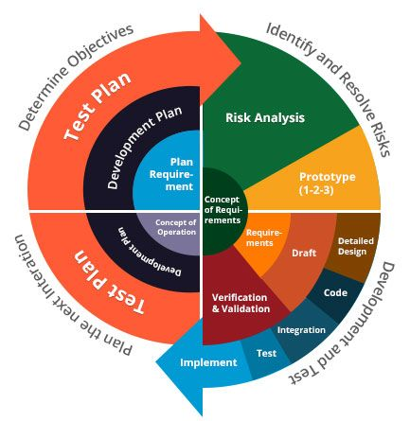
LIFE CYCLE MODEL
Diagram

Slide 19
Why To Choose Spiral Model
Better Risk Management
New Requirement Can be Accommodated
Requirements Can be captured more accurately
Users see the system early
Customer can see and review the test at each stage

Slide 20
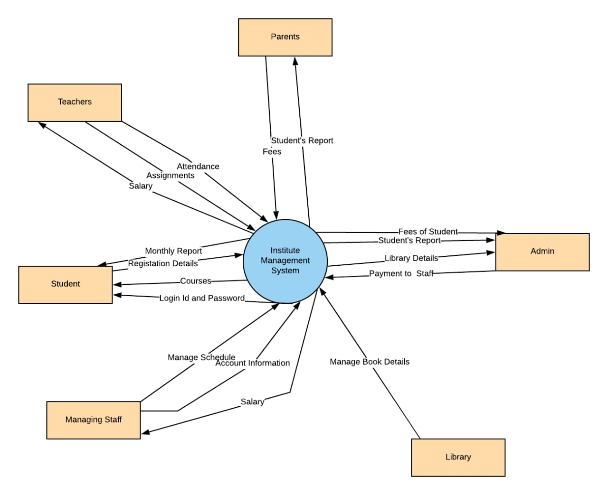
Function Oriented Design 1) Context Diagram

Slide 21
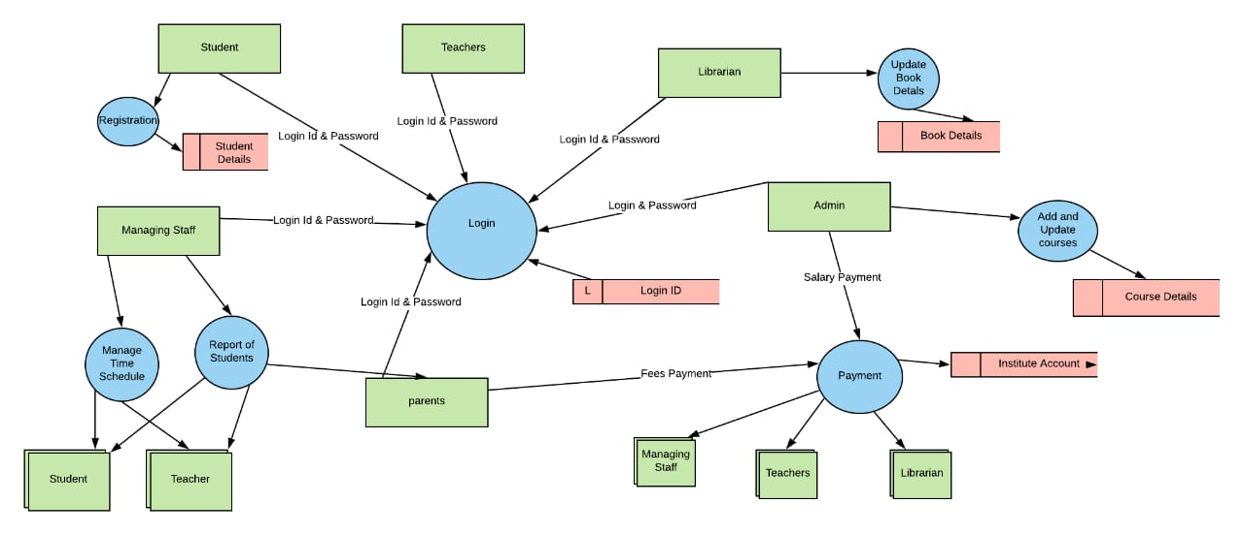
Function Oriented Design 2) DFD LEVEL 1

Slide 22
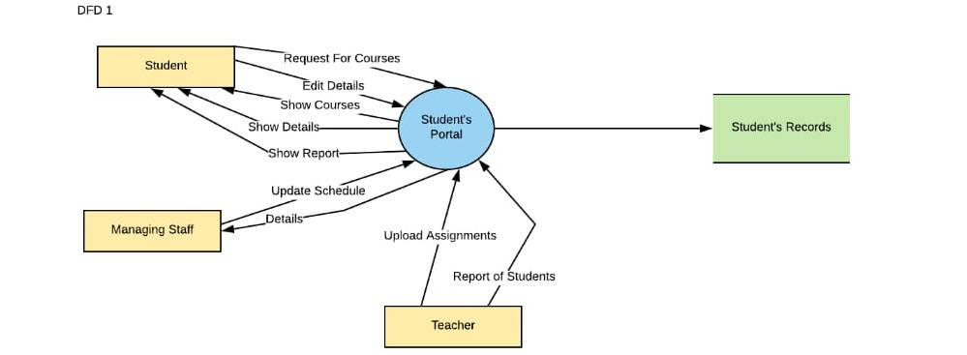
Function Oriented Design DFD LEVEL 2

Slide 23
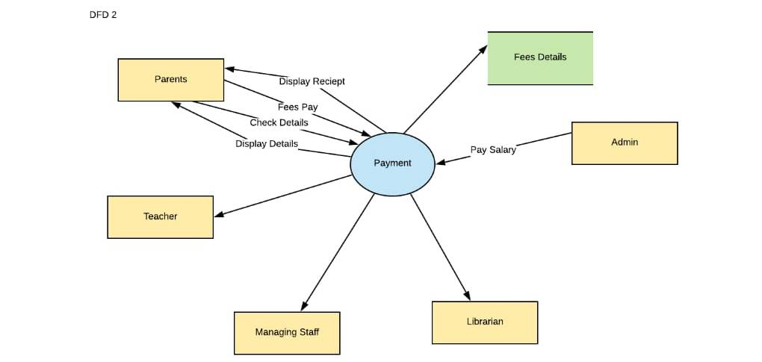
Function Oriented Design DFD LEVEL 2

Slide 24
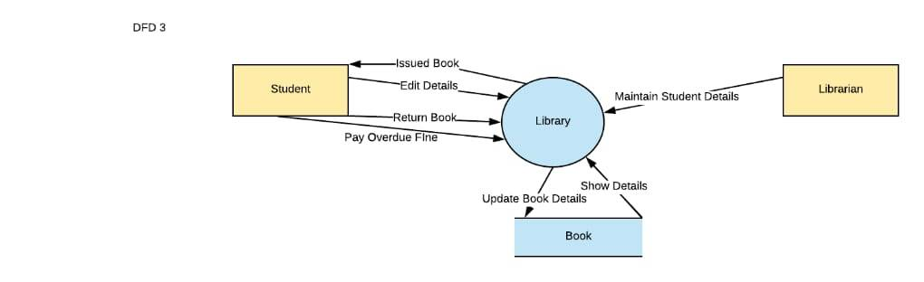
Function Oriented Design DFD LEVEL 2

Slide 25
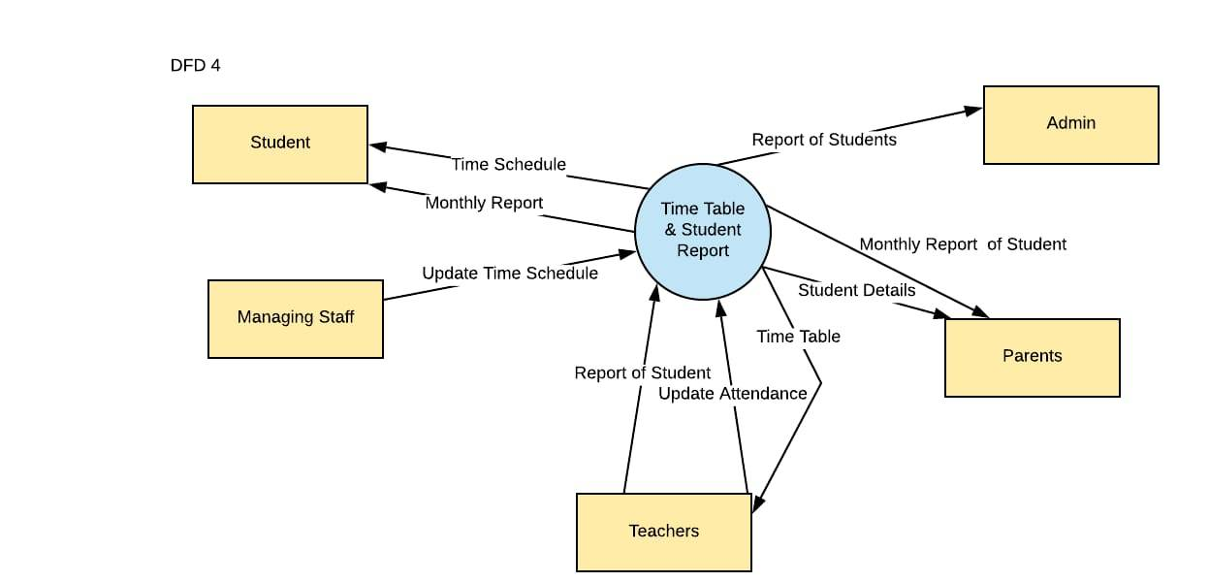
Function Oriented Design DFD LEVEL 2

Slide 26
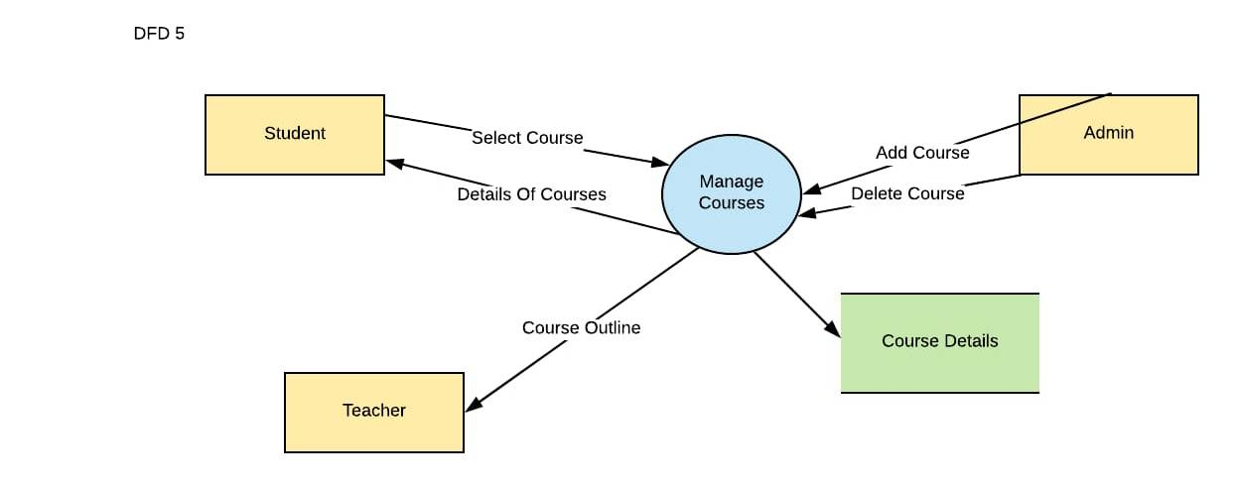
Function Oriented Design DFD LEVEL 2

Slide 27
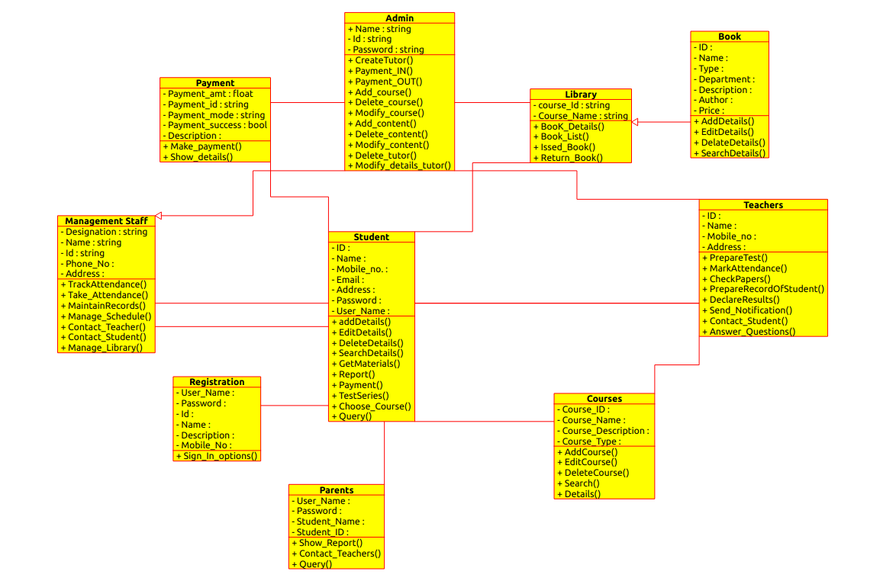
Object Oriented Design Class Diagram

